Slide 1
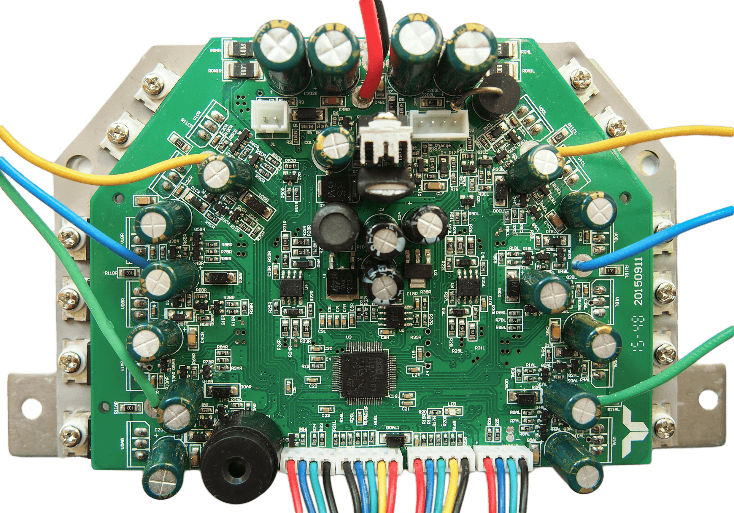
Power Button
XT60 Main Power
PA1 / Button Pin
Charger Connector
PA5 / Latch Pin
PA12 / Charger Pin
Motor Wires
Right Motor Current
PC5 / Phase C
Left Motor Current
PC4 / Phase B
PC3 / Phase B
SWD Programming
PA0 / Phase A
3.3V 30mA max.
DC Link Current
PA14 / SWCLK
PC0 / Left Motor
GND
PC1 / Right Motor
PA13 / SWDIO
Left Hall Cable
Right Hall Cable
GND
5V 100mA max.
HALL A
HALL A
HALL B
HALL B
HALL C
HALL C
5V 100mA max.
GND
Left Sideboard
Right Sideboard
15V 200mA max.
15V 200mA max.
PA2 / TX / ADC1
PB10 / TX / SCL
PA3 / RX / ADC2 / PPM
PB11 / RX / SDA
GND
GND

